Slide 1

Feature selection for svms
via Mixed Integer Linear Programming
Maldonado, Pérez, Weber, Labbé

Slide 2

Overall structure
Feature selection for SVMs

Slide 3

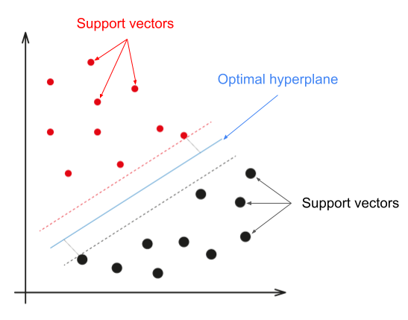
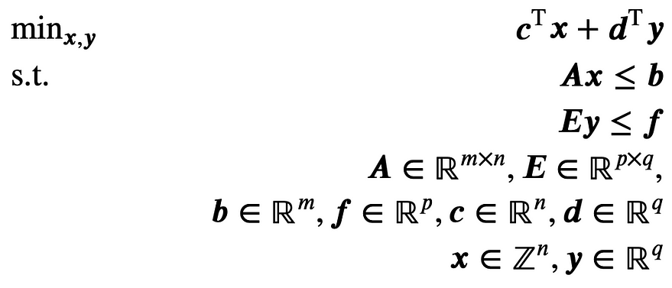
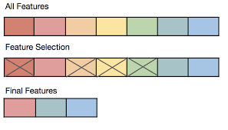
Overall structure
Formulations
SVM
Feature Selection
MILP
Motivation
Existing methods
Proposed methods
Results

Slide 4
Motivation
Feature selection for SVMs

Slide 5
Motivation
SVMs provide several advantages
Feature selection is an important topic within classification
Selection of the best subset is considered NP-hard
This paper shows that applying integer programming on 2 embedded methods is a competetive approach

Slide 6
Method summary
Feature selection for SVMs

Slide 7
Method Summary
Existing methods
Proposed methods
l₂-SVM
LP-SVM
l₁-SVM
Fisher + SVM
RFE-SVM
l₀-SVM
MILP1: l₁-SVM adapted to Mixed Integer Programming formulations
MILP2: LP-SVM adapted to Mixed Integer Programming formulations

Slide 8
THANK YOU
Botond Kovács

